Slide 1
Privacy, Security, & Scam Defense
When using Social Media, The Web, and even E-Mail

Slide 2
Social Media & Privacy
Yes this is one of those counterintuitive things.
Every social media service has an area for you to manage your privacy settings.
These settings allow you to manage who sees what information when they look at your profile
Lets have a look at my LibraryThing account for an example. (because I don’t have a Facebook account …yes I know I’m not with it.)

Slide 3
LibraryThings’ Privacy Settings
Some social media / e-mail sites like to hide the settings' option for some reason.
Keep an eye out for:
One of these is bound to take you to a screen like this.

Slide 4
1
2
3
4
Notes:
All of these settings govern the various privacy aspects of your account. From who gets to see and send you e-mails, who can view your profile info, to whether or not your posts are private or public. Every Social media site will have settings along these lines…they may be different but they will be there. The key one to remember is the selection for making your account viewable to: Everyone, Friends only, or Private / Invite only. If you found this you found the right place to go to control your privacy / security settings.

Slide 5
Facebook Folks & Privacy
Facebook is (currently) by far the largest social media site…that makes it target #1.
The folks at Facebook know this and have made privacy & security a high priority.
They have also set up a very nice set of tutorials That explain how your accounts privacy & security settings work. Complete with videos. https://www.facebook.com/about/basics
If any Facebook folks care to comment on this you’re welcome to do so.

Slide 6
On to Scam Spotting & Defense
The old saying “If it sounds to good to be true it probably is.” still holds true today.
Companies you have accounts with (Cable, internet, phone, banks, etc…) know your name, phone #, and account info … they won’t ask you for it … especially by e-mail or website popup.
Lets take a look at an example scam e-mail message.

Slide 7
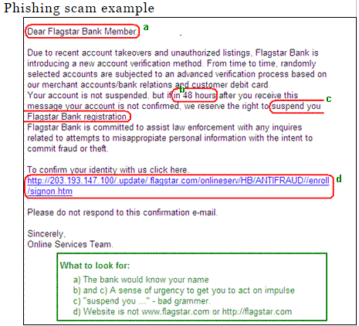
Thanks to Computers Confuse Me for the example: http://www.computersconfuseme.com/articles/phishing-scams/
Notes:
If this were your real bank they would know your name and use it. Anything with a time limit is questionable as it makes you feel like you need to act now. A big key give a way is bad grammar & spelling as no professional organization would allow such mistakes. And lastly website links are always a red flag as most corporations will tell you just to go and log into your account on their site, and they really won’t give you a link to a non-corporate site.

Slide 8
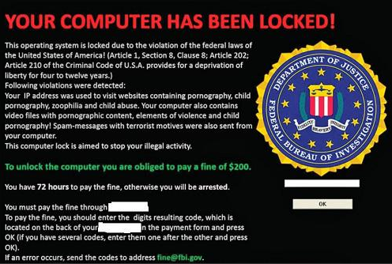
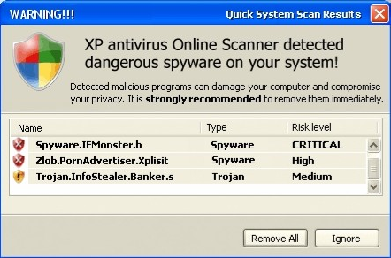
Scareware: Don’t be afraid
Scareware is software that tries to scare you into doing something that you don’t want to do.
Notes:
These are examples of scareware screens. They will try to make you think that either you or your computer has some how done something illegal, wrong, other otherwise disastrous! Don’t be fooled. The federal government (contrary to popular belief) doesn’t watch everything you do online, and if you are doing something illegal and get caught they don’t post a fine screen to your computer…they show up and arrest you.
The other example up here is a example of a virus scareware. It pops up and says your computer caught a dangerous virus. It even has a few giveaways too. Is it from your installed antivirus…nope, does windows XP (vista, 7, 8, etc…) have a built in antivirus … nope. Has your antivirus reported that it found one…bet not. Safest way to close one of these windows, because clicking on it could be bad, is to use ALT & F4 at the same time…this closes the current active window.

Slide 9
Tools To Protect You! And they are Free…yes Free!
Avast = Antivirus
Avast is a free antivirus that has versions for all tech devices…including your smart phone.
Their free version defends you against computer Viruses and auto updates itself.
MalwareBytes = Antispyware
Malwarebytes protects you from all those annoying pop-ups, page hijackers, and other garbage we don’t like sneaking onto our computers. … Sorry no Mac version.

Slide 10
Tools To Protect You Cont.
Windows Defender (AKA Windows Security Essentials) = Antispyware
Defender is Microsoft’s free antispyware tool
Your probably wondering where to get these tools. Wonder no more.
Avast: https://www.avast.com/en-us/index
MalwareBytes: https://www.malwarebytes.org/
Windows Defender: http://windows.microsoft.com/en-us/windows/security-essentials-download

Slide 11
Conclusion
If you stop and really read before clicking you will notice when someone is trying to scam you.
Don’t Panic! It won’t help so just stay calm and you’ll do fine…computers can always be fixed.
Keep your computers antivirus & malware protection updated, and run the scans at least once a month…or whenever you think you have a problem.
When in doubt seek help from Google (or your friendly neighborhood librarian)…it’s amazing how many of these things are reported by other people.

Slide 12
Any Questions???

